Slide 1



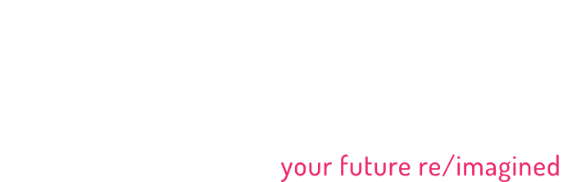


Pop Midterm A Surprise Test
PRESENTED BY:
Darie “Tester” Dorlus
Chief Testing Ninja
darie@bocacode.com

Slide 2
Ready?
What’s in a Test?

Slide 3
Software Testing
Is the process of verifying and validating that a software is mostly bug-free, meets technical and user requirements effectively (efficiently), while also handling all exceptional and boundary cases

Slide 4
Software Testing
is the process of finding (or preventing) errors in a developed product

Slide 5
Types Of Testing
Manual
Automated

Slide 6
Tails of 3 Companies
Direct Insite VS Cendyn VS UKG

Slide 7
Software Testing Techniques
White Box
Black Box

Slide 8
White Box
Intimate Knowledge of product or access to source code

Slide 9
Black Box
The opposite of White

Slide 10
Automated Testing
Unit Testing
Integration Testing
System Testing
Acceptance Testing

Slide 11
Shall We Test?

Slide 12
Thank You.

